Slide 1
Subcontracts/Payroll/DBE
Jimmy Johnson

Slide 2
SUbcontracts
Make sure there is a subcontract for any contractor other than the Prime that is working on the job. If the Inspector can’t pick them from the drop down on an item, something is wrong. Please check with Central Office Construction so we can help you figure it out.
Make the Contractor aware of any obvious errors you see on the payrolls.

Slide 3
PAYrolls
If it’s a Federal Project, you will have to have payrolls for every week for every contractor working. Please make sure your inspectors are assigning pay items to the correct contractor. This will help any confusion with who was on the site and who should and shouldn’t have a payroll.
Section Offices have had success asking the Primes to submit all the payrolls for the project so they are responsible for ensuring all the subcontractor payrolls are submitted. Because their estimate will be held if the payrolls are not up to date, it puts the responsibility on them. Less confusion for the section office getting payrolls from multiple companies at multiple times.

Slide 4
Payroll tracking spreadsheets Credit: Rob Harris
 |  | WEEK STARTING |  |  | WEEK STARTING |  |  | WEEK STARTING |  |  | WEEK STARTING |  |  | WEEK STARTING |  |  | WEEK STARTING |  |  | WEEK STARTING |  |  | WEEK STARTING |  |  | WEEK STARTING |  |  | WEEK STARTING |  |  | WEEK STARTING |  |  | WEEK STARTING
 |  | 01/03/16 |  |  | 01/10/16 |  |  | 01/17/16 |  |  | 01/24/16 |  |  | 01/31/16 |  |  | 02/07/16 |  |  | 02/14/16 |  |  | 02/21/16 |  |  | 02/28/16 |  |  | 03/06/16 |  |  | 03/13/16 |  |  | 03/20/16
CONTRACTOR NAME |  | WORKED | PAYROLL RECEIVED |  | WORKED | PAYROLL RECEIVED |  | WORKED | PAYROLL RECEIVED |  | WORKED | PAYROLL RECEIVED |  | WORKED | PAYROLL RECEIVED |  | WORKED | PAYROLL RECEIVED |  | WORKED | PAYROLL RECEIVED |  | WORKED | PAYROLL RECEIVED |  | WORKED | PAYROLL RECEIVED |  | WORKED | PAYROLL RECEIVED |  | WORKED | PAYROLL RECEIVED |  | WORKED | PAYROLL RECEIVED
A&A CONCRETE SAWING |  | NWP | 1/21/16 |  | X | 1/21/16 |  | X | 2/5/16 |  | X | 2/5/16 |  | X | 2/19/16 |  | X | 2/19/16 |  | X | 3/11/16 |  | X | 3/11/16 |  | X | 4/29/16 |  | X | 4/29/16 |  | X | 4/29/16 |  | X | 4/29/16
ABC CUTTING |  | X2 | 1/29/16 |  | X/2 | 1/29/16 |  | X3 | 3/18/16 |  | X | 2/12/16 |  | X2 | 3/11/16 |  | X | 2/19/16 |  | X | 2/26/16 |  | X2 | 3/11/16 |  | X2 | 3/11/16 |  | X | 3/18/16 |  | X2 | 3/25/16 |  | NWP1 | 5/5/16
ASSOCIATED COST ENGINEERS (ACE)
BADGER DAYLIGHTING CORP. |  | X | 1/21/16 |  | NWP | 1/29/16 |  | X | 2/5-8/16 |  | X | 2/12/16 |  | NWP | 2/19/16 |  | NWP | 2/26/16 |  | NWP | 3/4/16 |  | X | 3/11/16 |  | NWP | 3/18/16 |  | X | 3/25/16 |  | X | 4/1/16 |  | X | 4/8/16
BEATY
BERGER
BERKEL & COMPANY CONTRACTORS
BRAYMAN CONSTRUCTION CORP.
BROADY CAMPBELL
BUNN ENTERPRISE
 |  |  |  |  |  |  |  |  |  |  |  |  |  |  |  |  |  |  |  | 14-Feb |  |  | 21-Feb |  |  | 28-Feb |  |  | 6-Mar |  |  | 13-Mar |  |  | 20-Mar
NWPC = NO WORK PAY CORRECTION
MONTH/YEAR NOTATION = MISC FILE

Slide 5
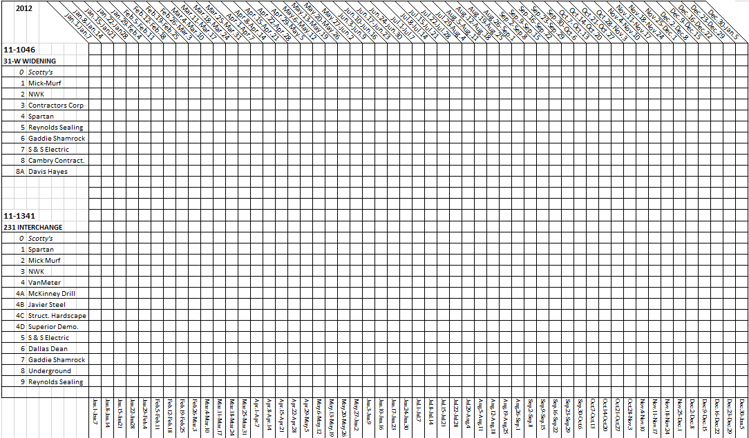
Payroll tracking spreadsheets Credit: Travis Spidel

Slide 6
Dbe Payments
Contractor’s must report payments to OCRSBD including:
Report including check number, CID, amount, and check date.
Notarized affidavit (TC 18-7).
Copies of canceled checks.
Must be submitted within 10 days of payment by KYTC

Slide 7
Prompt DBE payments and why it Matters?
49 CFR Part 26.29 (a) says, the state agency must establish a contract clause for prompt payment, and then must have methods to comply with this requirement.
KYTC chose 10 days as the requirement for payment and withholding progress payments as the method to ensure compliance.

Slide 8
DBE payments and Finals
Construction is checking with OCRSBD for proof of payments to DBE prior to processing the final estimate.
OCRSBD is looking at subcontracted amount. This usually requires Construction to become involved because:
Primes have not submitted all documents as per the contract.
OCRSBD is looking at the original subcontract amount—VERY unlikely this is the amount paid to the subcontractor.
This is why there is a backlog of finals sent in by the Districts to Construction that have not been closed.

Slide 9
DBE payments and Finals
Construction generates a report that shows the amount paid on the DBE subcontracted items.
This paid amount is provided to OCRSBD so they can verify payment certification equals this amount
Retainage for bonds and insurance cannot be withheld.

Slide 10
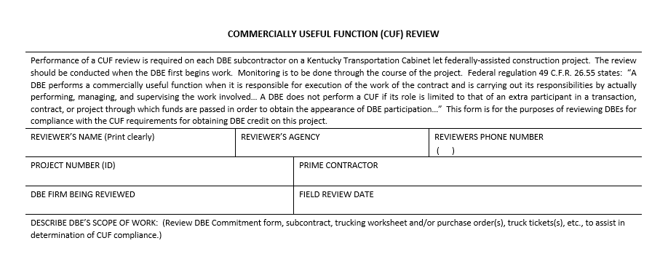
CUF FOrm

Slide 11
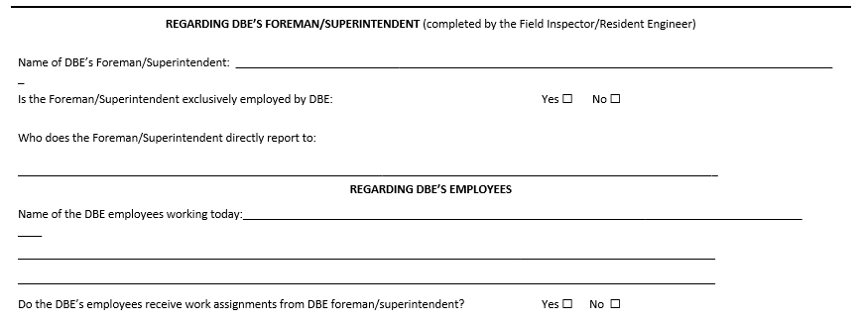
CUF Form

Slide 12
Cuf form

Slide 13
Lifetime Project tracking
Tips from various section engineers

Slide 14
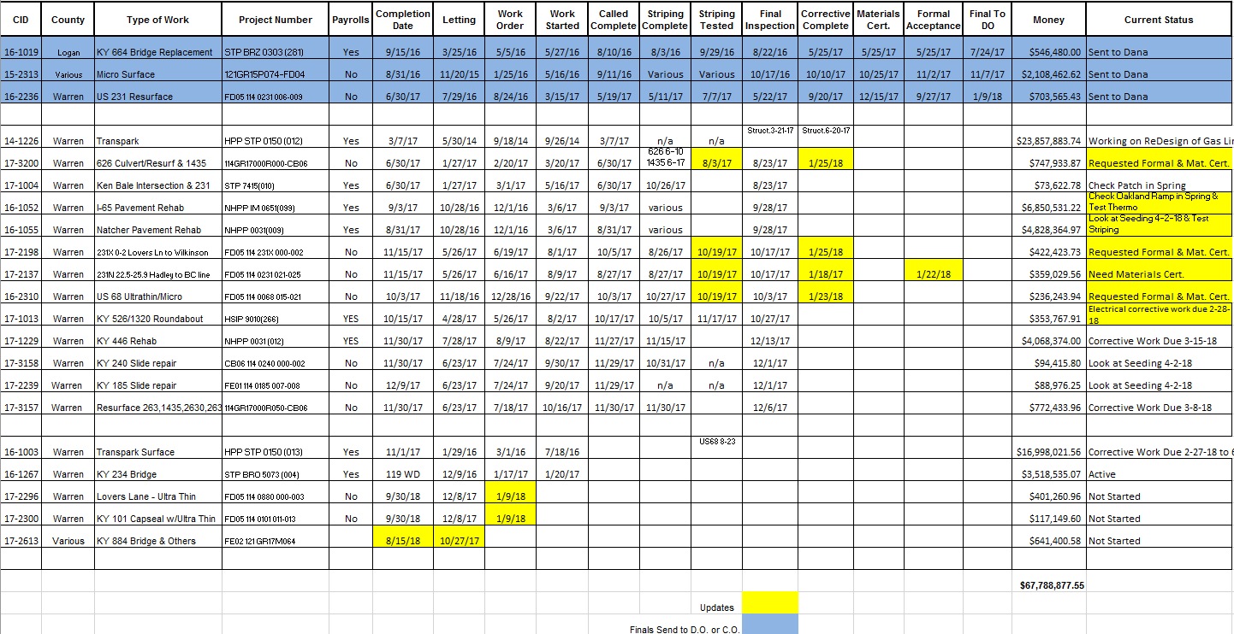
Project Lifetime Tracking Spreadsheet—Key Dates and Critical Dates and Current Status
Credit: Travis Spidel

Slide 15
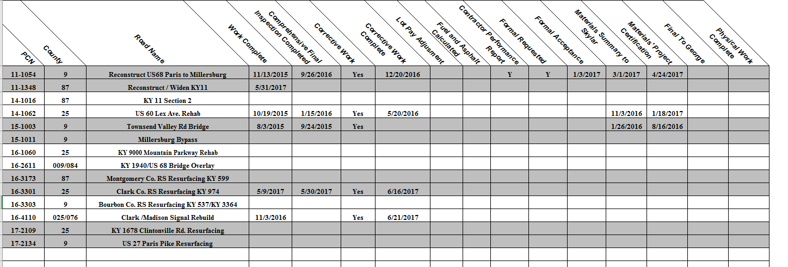
Project Lifetime Tracking Spreadsheet-Tracks Section Office and District Office Responsibilities and dates
Credit: Jonathan Taylor

Slide 16
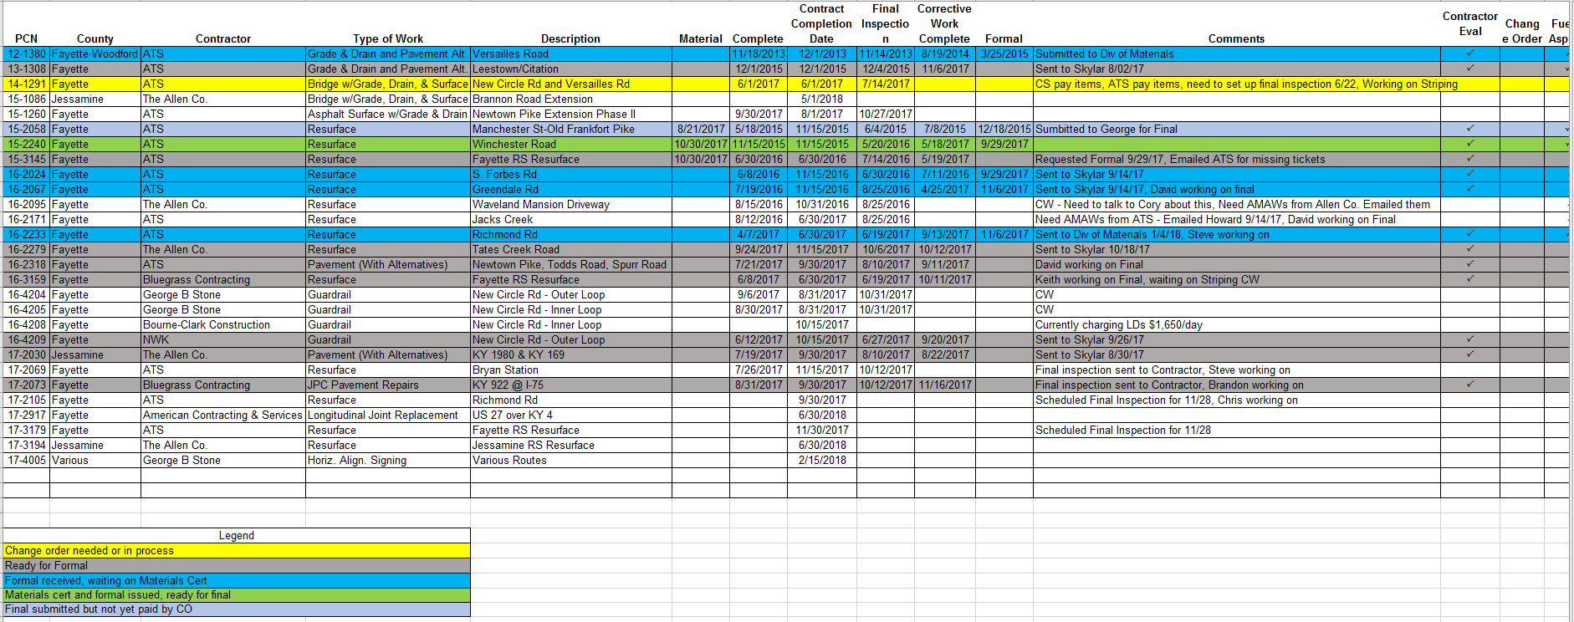
Project Lifetime Tracking Spreadsheet—Helps track key dates and final checklist items.
Credit: Tony McGaha

